Slide 1

CEP Project Presentation On Topic Finalization
Digital Notice Board
PRESENTED BY
SECOF42 - Mihika Titar
SECOF50 - Vedanti Tete
SECOF53 - Aditi Wagh
SECOF63 - Sakshi Yelpale
Guided By:
Prof. Pratik S. Chopade
Academic Year: 2025-2026
DEPARTMENT OF COMPUTER ENGINEERING
PIMPRI CHINCHWAD COLLEGE OF ENGINEERING & RESEARCH PUNE
(An Autonomous Institute)

Slide 2
CONTENT
Abstract
Introduction
Problem Statement
Motivation
System Architecture
Survey
Objectives
Software Hardware requirements
Conclusion

Slide 3
ABSTRACT
Problem: Traditional notice boards are often inaccessible, slow to update, and physically dependent.
Solution: We have developed a Digital Notice Board Website to provide a centralized, web-based platform.
Functionality: Authorized users can instantly post announcements, schedules, and circulars for students to access anytime, anywhere.
Benefits: The system improves communication efficiency, reduces paper usage, and ensures timely information delivery.

Slide 4
INTRODUCTION
Communication is a key part of any institution.
Traditional notice boards are limited by time, space, and accessibility.
Students often miss important updates due to dependency on physical boards.
To solve this, we propose a Digital Notice Board Website for our department.
It will provide instant, organized, and easily accessible notices to students anytime, anywhere.

Slide 5
PROBLEM STATEMENT
In most colleges, important announcements are displayed on physical notice boards, which require students to be physically present to view them. This method does not allow real-time updates and often leads to missed information. Manual updating consumes time and resources, while repeated paper usage adds to waste. Therefore, there is a need for a centralized digital platform where faculty can instantly upload notices and students can conveniently access them anytime and anywhere, ensuring effective communication and reducing unnecessary delays.

Slide 6
Motivation
In colleges, students often miss important updates due to reliance on physical notice boards.
The growing need for instant and accessible communication inspired us to create a digital solution.
A web-based notice board reduces time delays, manual effort, and paper usage, making it more efficient and eco-friendlier.
With increasing digital adoption in education, building this project motivates us to contribute to modernizing campus communication and gaining practical skills in web development.

Slide 7
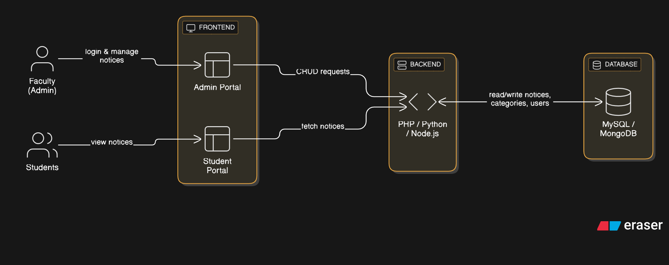
System Architecture

Slide 8
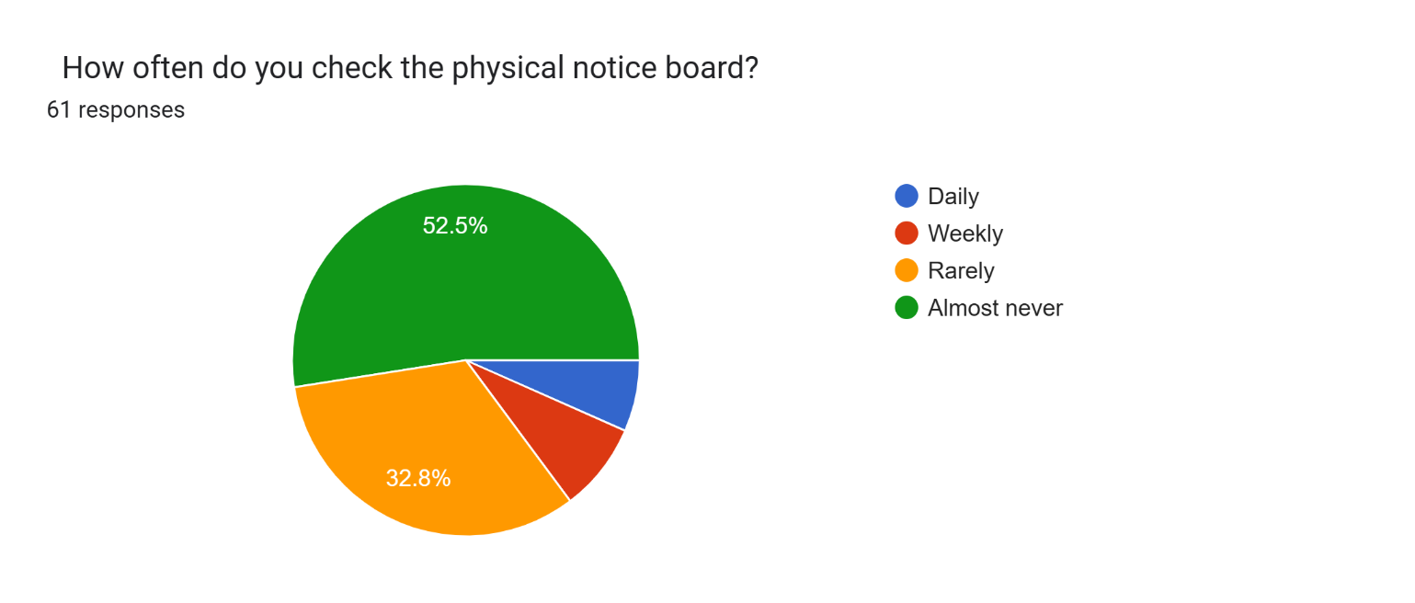
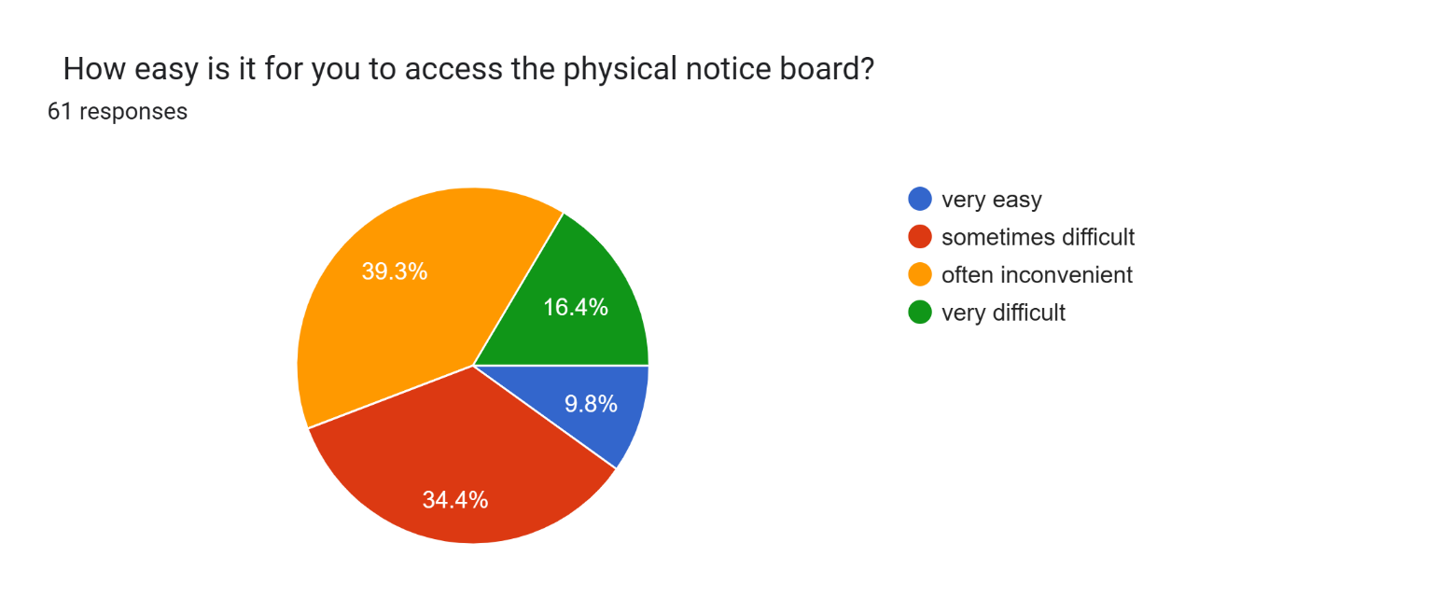
Survey

Slide 9
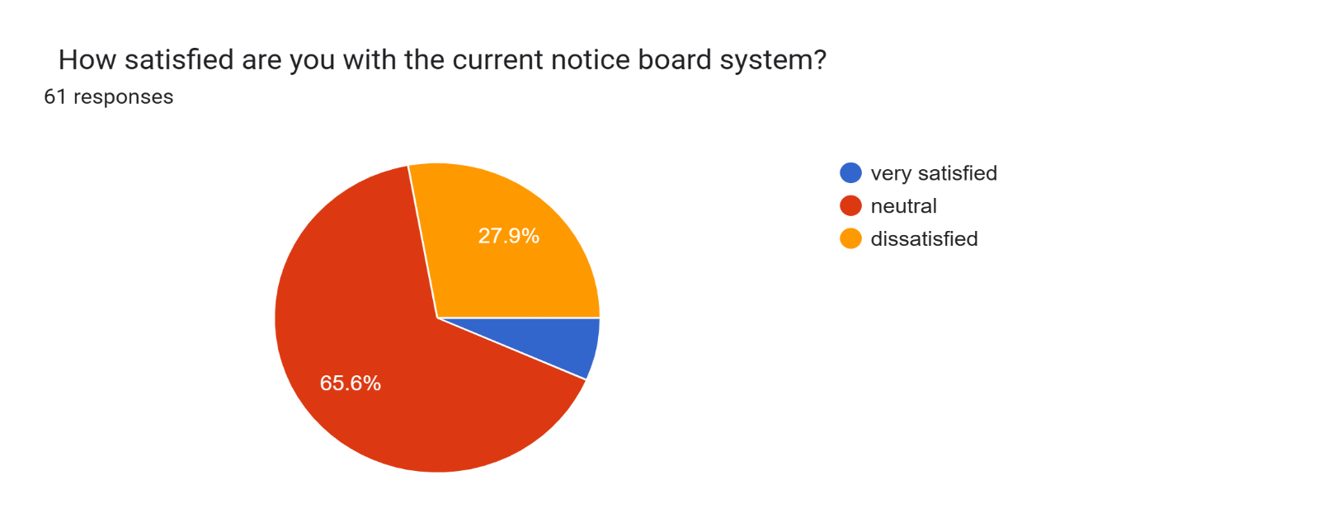
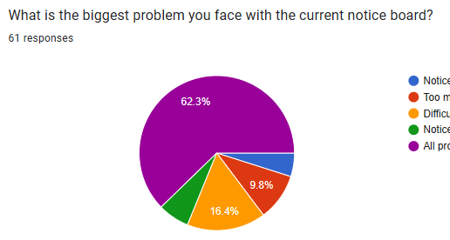
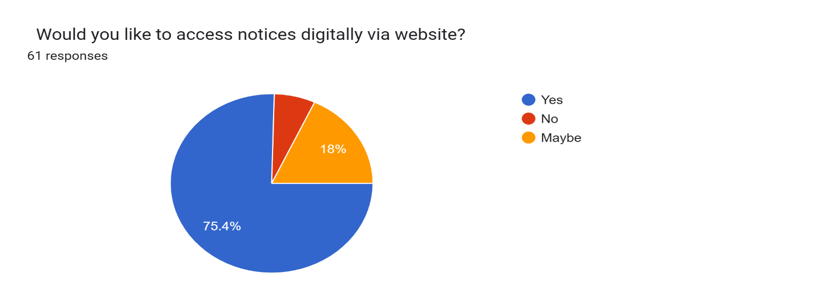
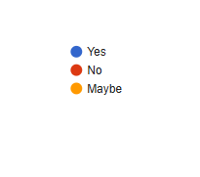
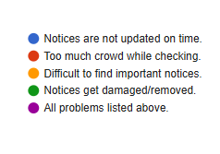
Survey

Slide 10
Objectives
To design and develop a centralized digital platform where all important departmental notices can be uploaded by faculty and easily accessed by students in real-time.
To enhance communication within the college by providing a reliable, quick, and organized way of delivering information so that no student misses out on important updates
To minimize the dependence on physical notice boards and paper usage by creating an eco-friendly, automated, and efficient digital alternative.

Slide 11
Software Hardware requirements
Software Requirements :
Operating System: Windows / Linux
Frontend: HTML, CSS, JavaScript
Backend: PHP / Node.js / Python
Database: MySQL / MongoDB
Tools: VS Code, XAMPP / Node Package Manager, GitHub for version control
Browser: Google Chrome / Mozilla Firefox
Hardware Requirements :
Processor: Intel i3 or above
RAM: Minimum 4 GB (8 GB recommended)
Hard Disk: 100 GB or more
Display: 15.6” monitor or above
Network: Stable internet connection

Slide 12
Conclusion
The Digital Notice Board provides a modern and efficient way to share important information within the college.
It reduces time delays, ensures accessibility from anywhere, and keeps students updated in real-time.
By minimizing paper usage, it also promotes an eco-friendly approach to communication.
Overall, this project enhances campus communication while giving us practical experience in web development.

Slide 13
Thank you !

